Slide 1
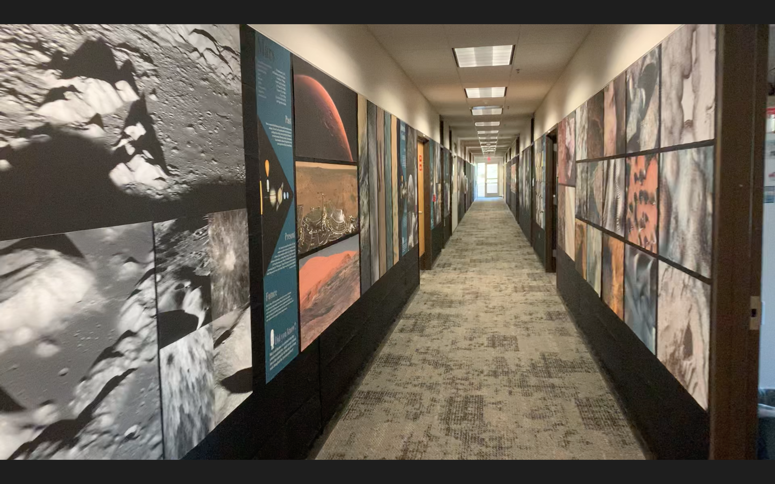
2021 Northern Arizona University NASA Space Grant
USGS Astrogeology Virtual Tour Guide
Student Anthony Kiefer
Mentor Greg Vaughan
Notes:
Who we are: The USGS science center in Flagstaff has created a unique exhibit within their hallways for the public to walk and see images of the surfaces of other worlds. At this point we are just finishing the captions so that when covid restrictions are over, people will have a better idea of what they are looking at.
The goal is to make a virtual tour guide, one that they can view either on their phones or on a dedicated tablet, that explains each photo as people walk along.
At this point in history, a person can go online and look at real pictures of almost every piece of our solar system, but there are few places they can go and see these images in print. There is something added to the experience of seeing Martian sand dunes through a huge, high definition print, versus a small computer screen. Public familiarity with the state of science and exploration is the goal of any science center.
Originally we had planned on doing a lot more hands-on work together at the science center, making this internship a mix of creating captions for the hallway pictures, AND the construction of additional exhibits. The science center has a large room with big plans for interesting exhibits, and I used to be the exhibits technician at the science center in san diego, so we were going to build scale model asteroids and some other stuff. But as we have all seen, Covid changed a lot of things, including access to the building. So, we just focused on that aspect of the project which we could do from home; the captioning of the photos for later installation into a virtual tour guide. I picked up an external hard drive full of gigabytes of photos, all the photos in all all the hallways, and I have been finding the information for these photos online.
Considering the circumstances, this presentation will just go over some of my favorite images. I was already familiar with the solar system, as I used to guide tours at Lowell observatory and have been a life long space-nut, but nevertheless I learned a lot. Here are some of the most striking images and some quick facts for you before my time is up.

Slide 2
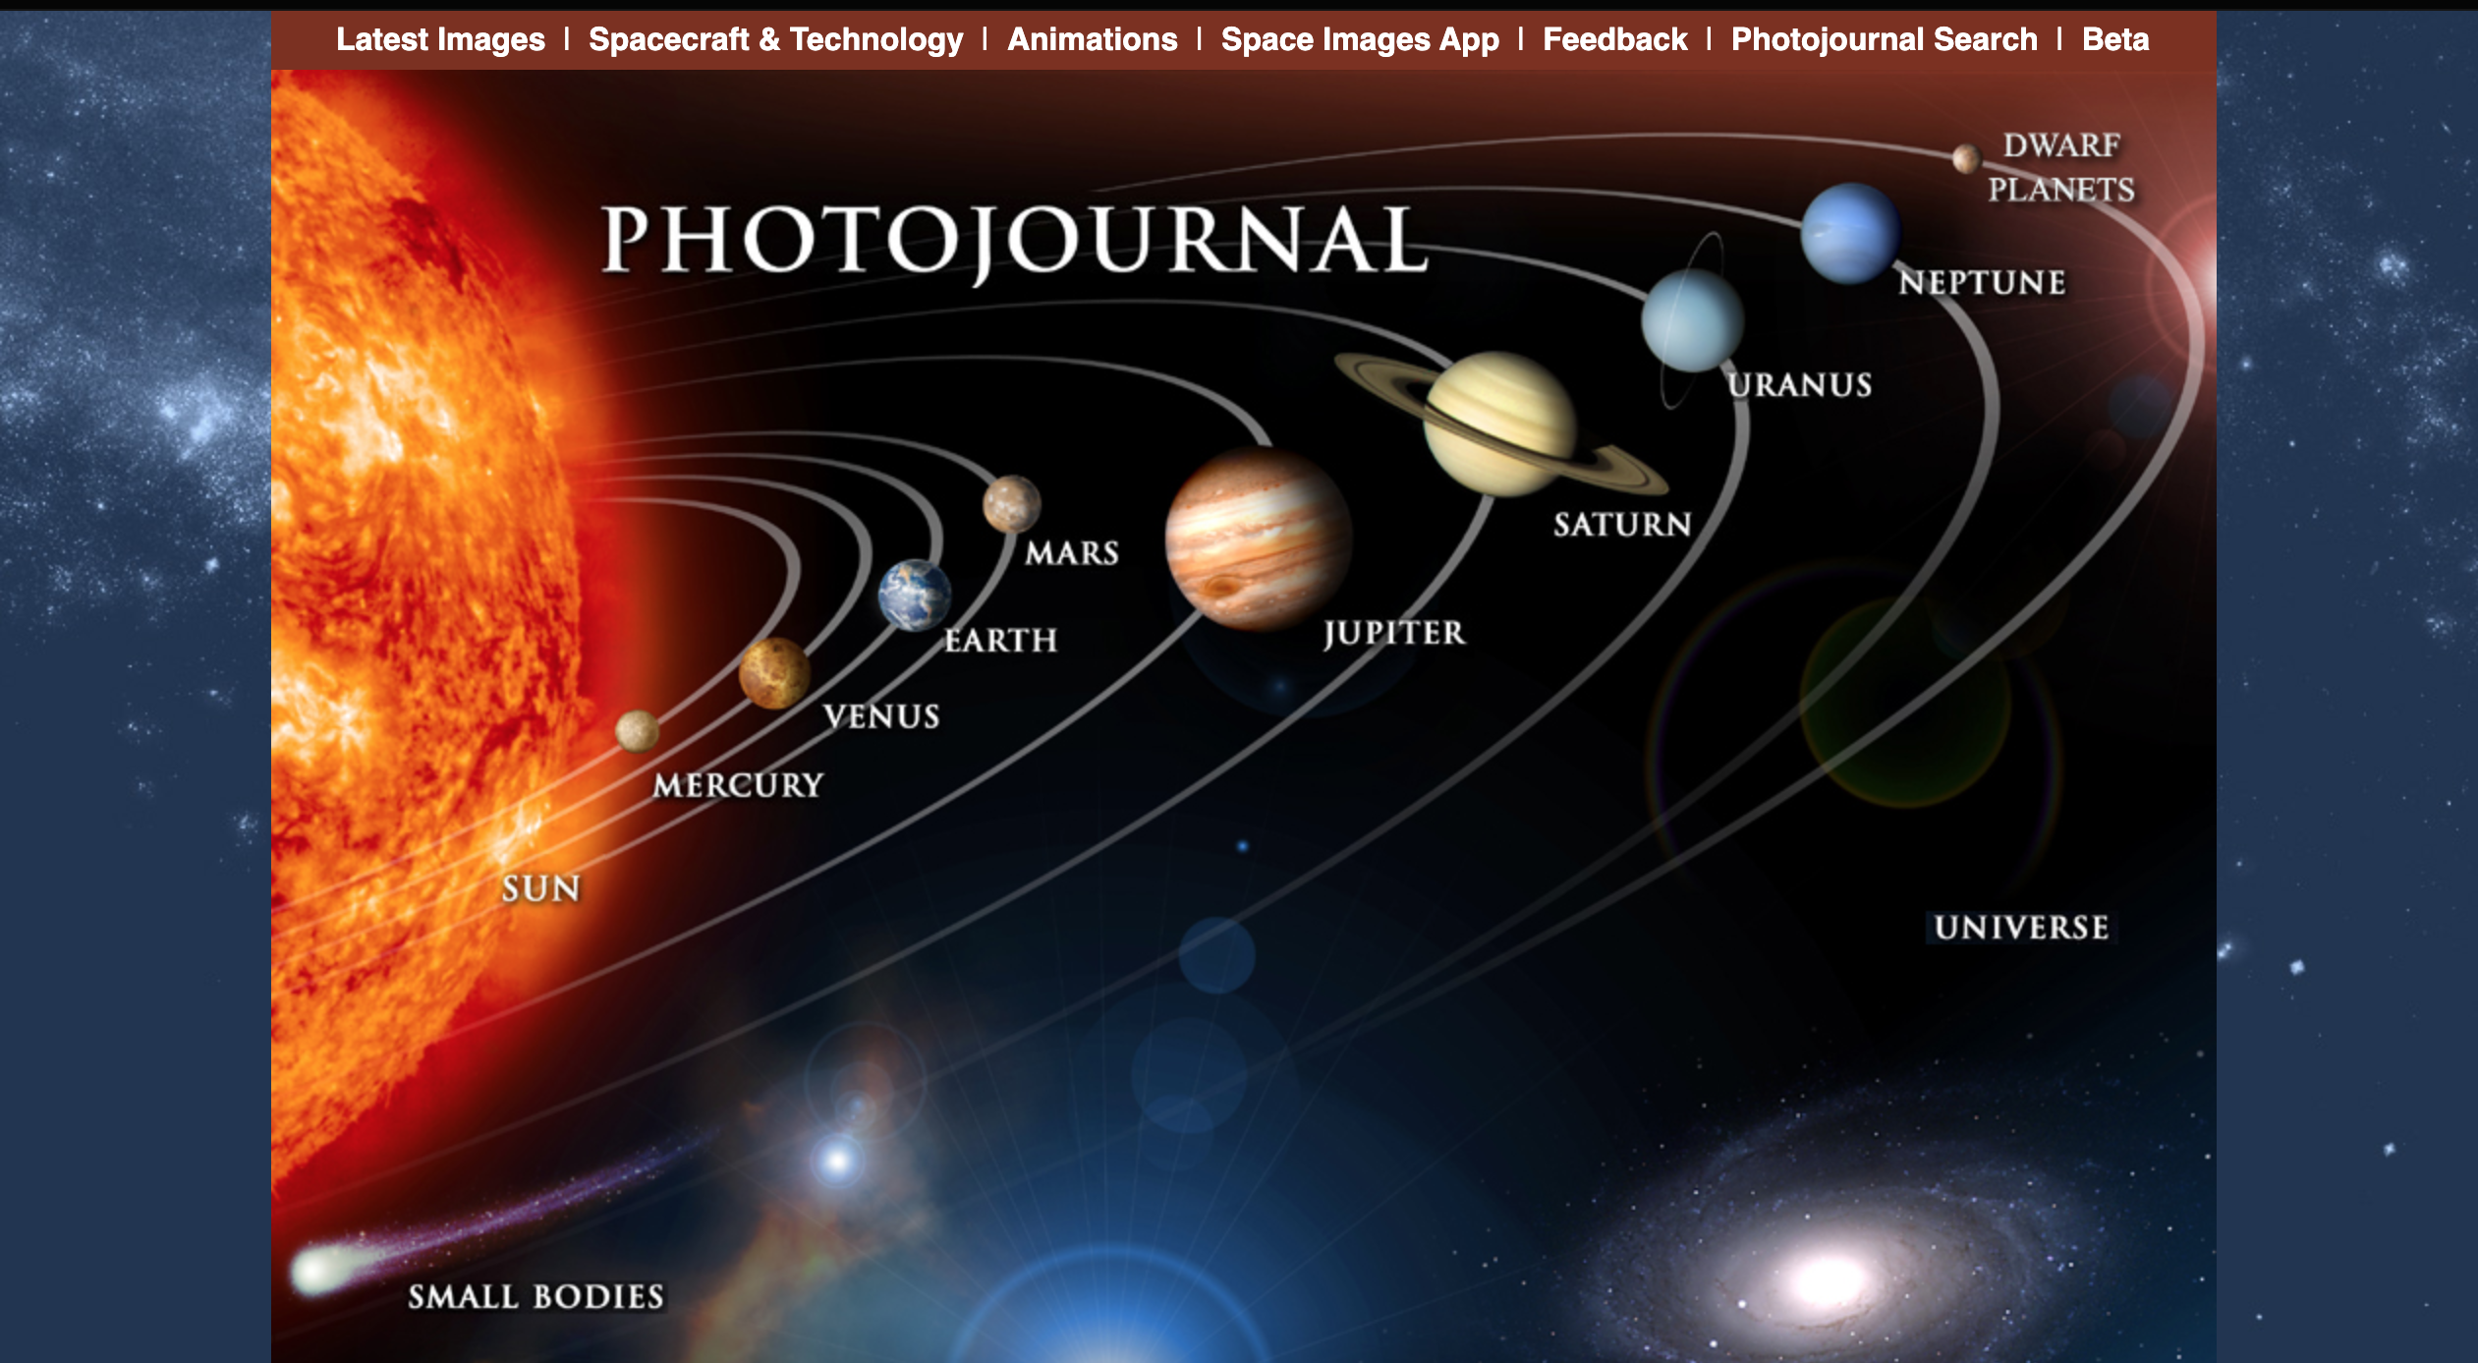
Notes:
Most of the photos are contained in NASA’s photojournal website, so I always checked here first. It’s a pretty awesome website and I encourage everyone to check it out. They have super high resolution photos and descriptions of pretty much everything captured by every space craft. Whenever I could not find a photo in here, I would go to google.
Google’s image search function has the option of uploading the photo you are trying to find, and their algorithms search the web for similar photos. It usually finds the exact photo, and if the photo was found on a reputable site, I used the info from their caption to write my own shorter version. The goal is to make a short enough caption that people will actually read it.

Slide 3
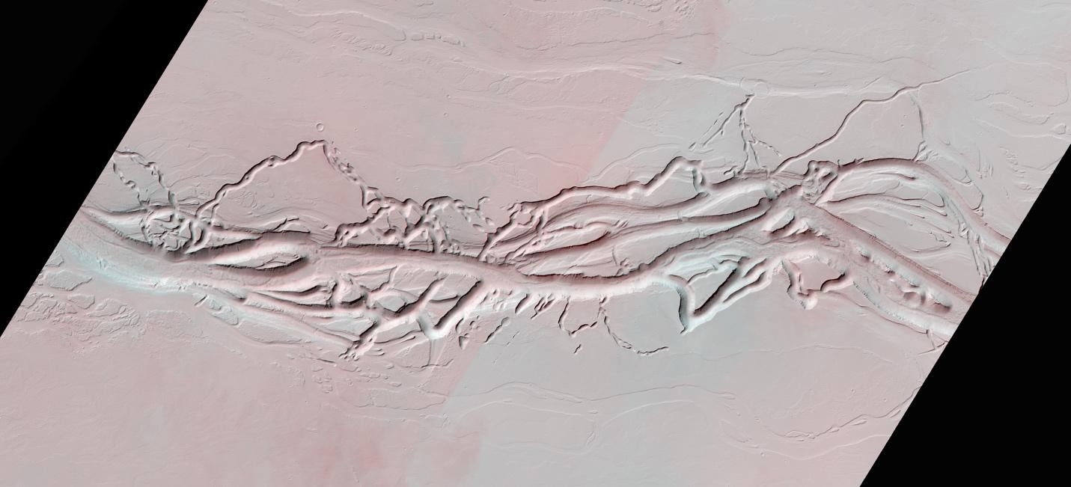
Mars
Notes:
A big section of the exhibit is for anaglyphs, AKA images that have been given a red-blue 3D effect. If anyone has 3D glasses, I highly recommend checking out NASA’s archive, and then visiting the Flagstaff USGS when the covid situation is better. Here is one anaglyph from Mars, a region named “Olympica Fossae”, which is a set of channels cut into the plains east of the biggest mountain in the solar system, Olympus Mons.

Slide 4
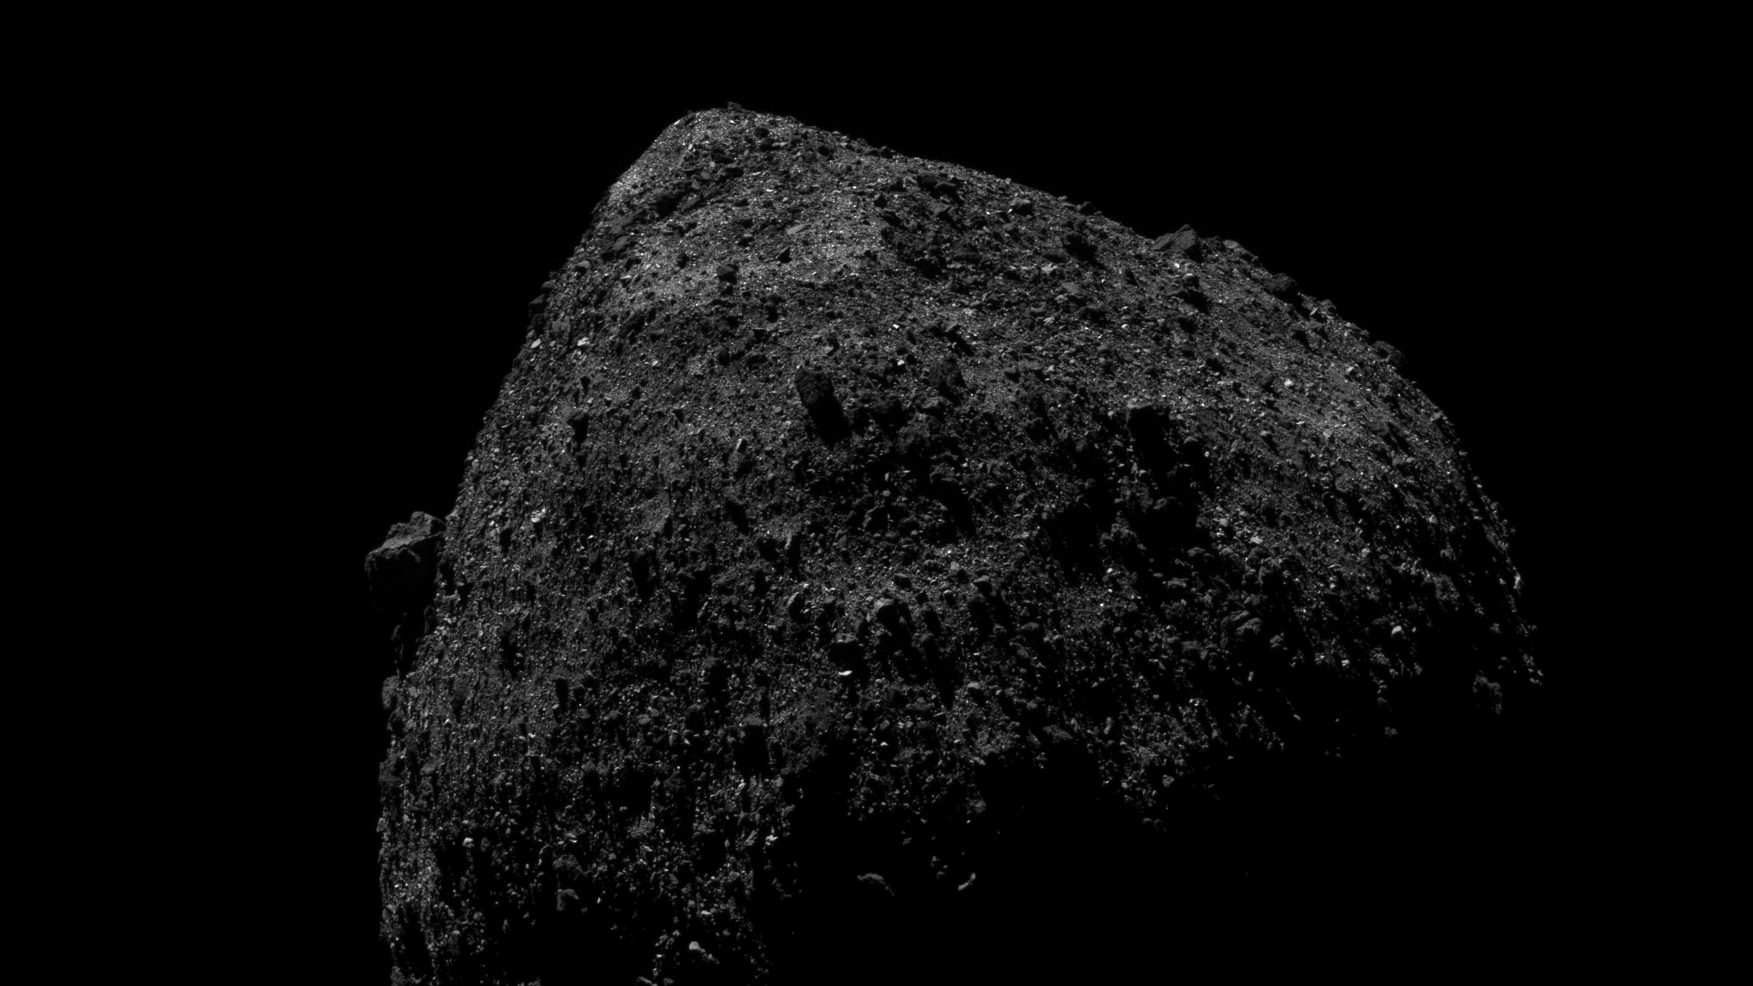
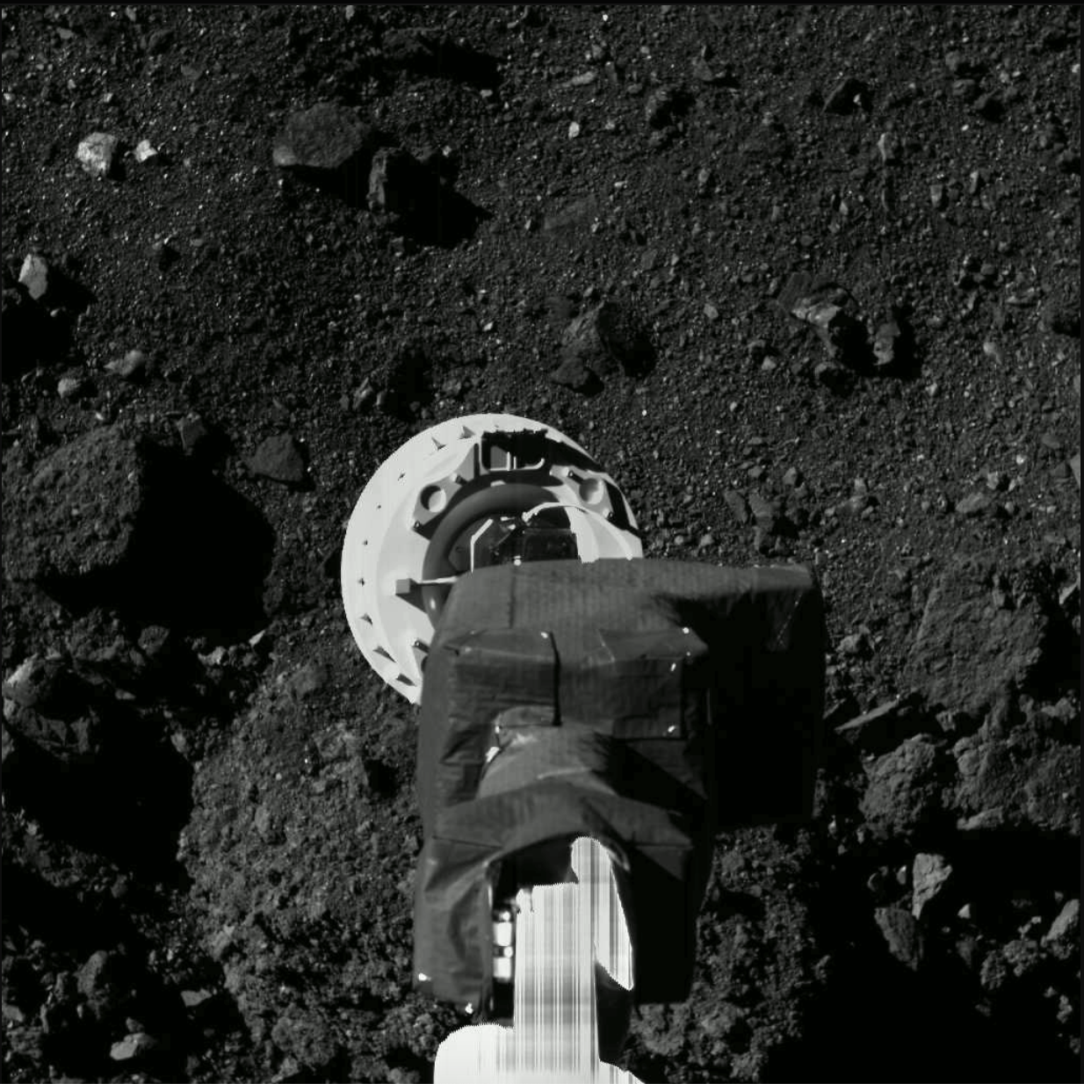
Bennu
Notes:
NASA’s first mission to return a sample from an ancient asteroid arrived at its target, the asteroid Bennu, on Dec. 3, 2018. This mission, the Origins, Spectral Interpretation, Resource Identification, Security-Regolith Explorer, or OSIRIS-REx, is a seven-year long voyage set to conclude upon the delivery to Earth of at least 2.1 ounces (60 grams) and possibly up to almost four and a half pounds (two kilograms) of sample.
It pretty much filled its sampling head that day, meaning it likely backed away from Bennu with about 4.4 lbs. (2 kilograms) of collected material. It will be the largest amount of extraterrestrial material brought back from space since the Apollo era.
It is expected to arrive back on Earth with the samples on September 24, 2023

Slide 5
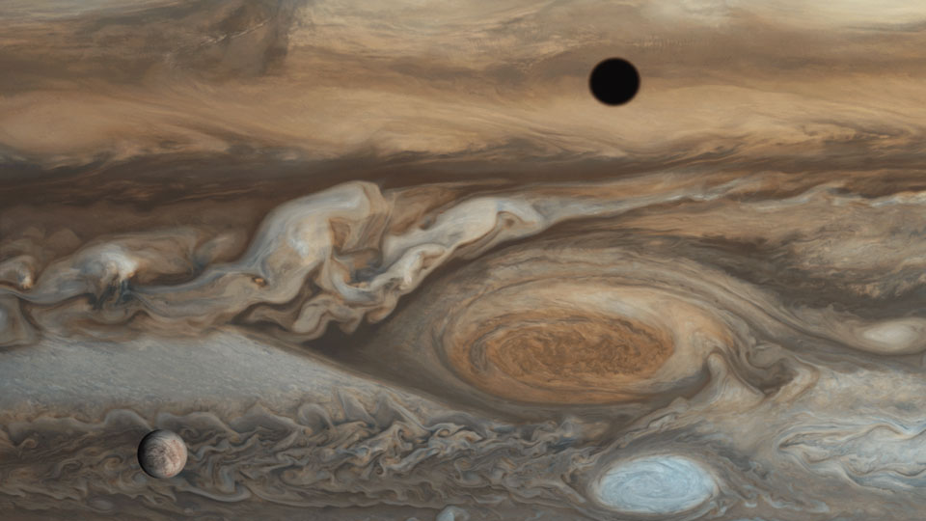
Io’s Shadow
Alien Octopus
Europa
Notes:
This photo from Jupiter by Voyager 1 shows the ice moon Europa, a shadow of the fire moon Io on Jupiter’s clouds, and the Great Red Spot which is a hurricane bigger than the earth.

Slide 6
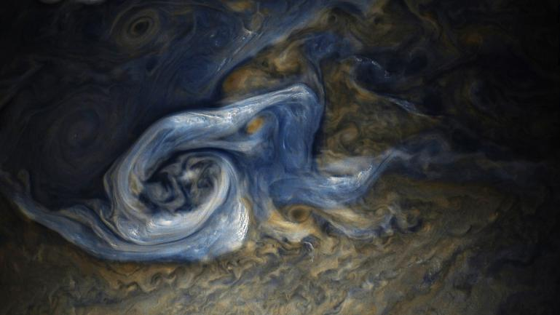
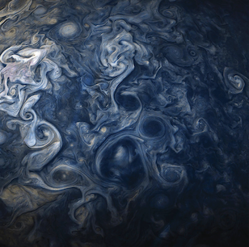
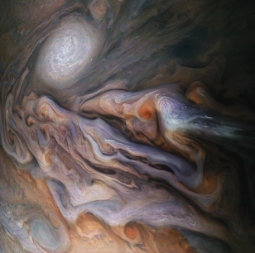
Jupiter
Notes:
https://photojournal.jpl.nasa.gov/catalog/PIA21971
Ever since Juno, I haven’t been able to get enough of Jupiter. These color-enhanced images of Jupiter’s interesting cloud structures were captured by NASA's Juno spacecraft. The northern hemisphere has some really interesting storms. The darker areas are deeper, while the lighter areas are higher up.

Slide 7
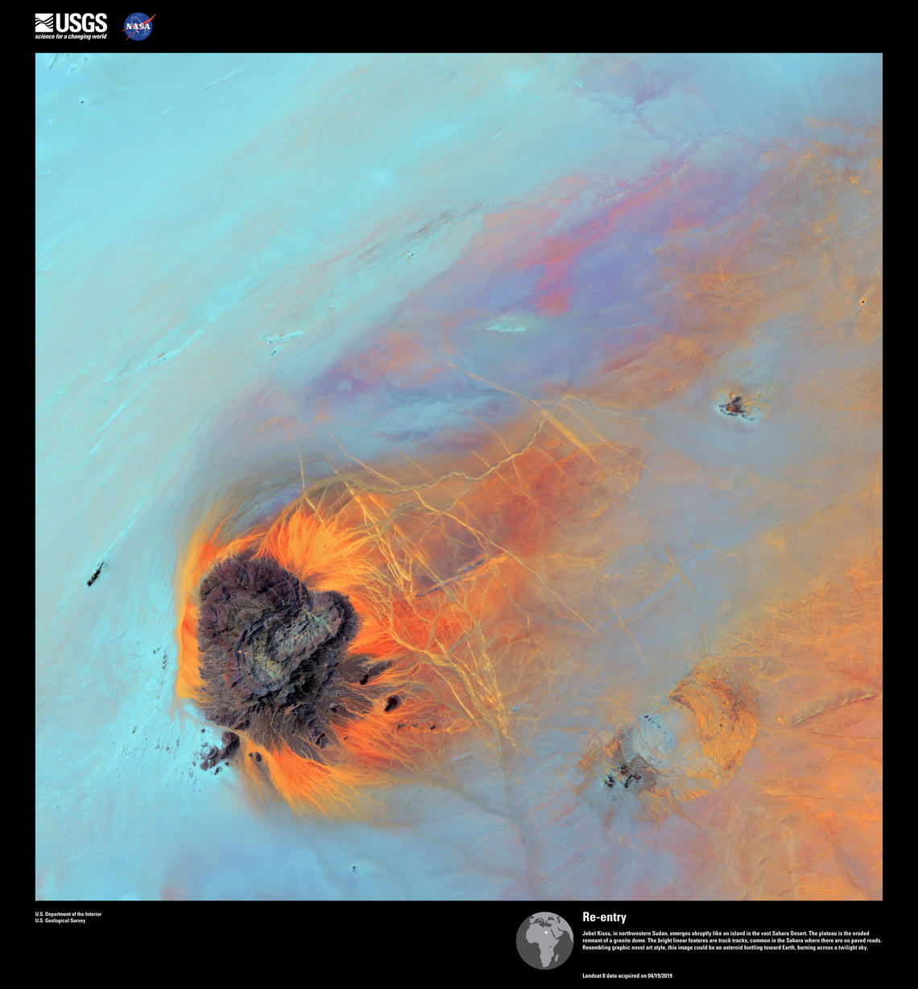
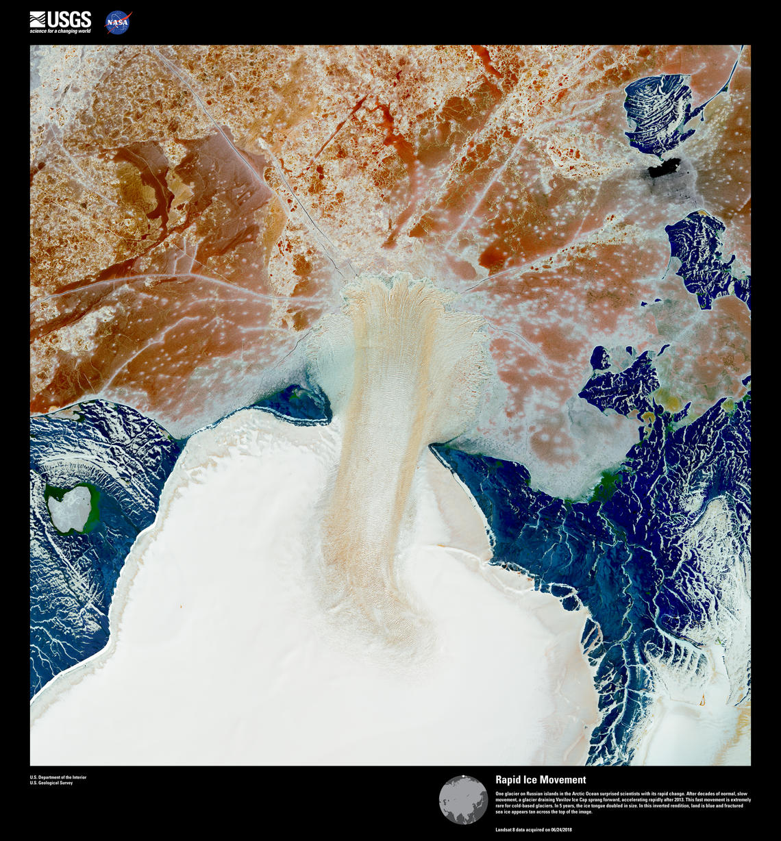
Sudan
Arctic Island
Notes:
And of course, Earth has a place in this show.
On the left, the eroded remnant of a granite dome in Sudan. It has a great name in the USGS webpage: They called it “re-entry” because it looks like a spacecraft re-entering the atmosphere.
On the right, a glacier on a Russian island in the Arctic surprised scientists with its rapid change. After decades of normal, slow movement, began accelerating rapidly in 2013. This fast movement is extremely rare for cold-based glaciers. The picture is inverted to make it easier to see details in the glacier, so the land is blue, and fractured sea ice is the tan stuff across the top of the image.

